Slide 1
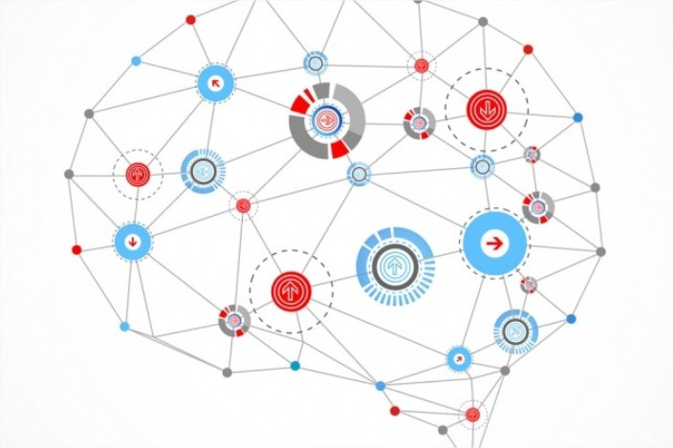
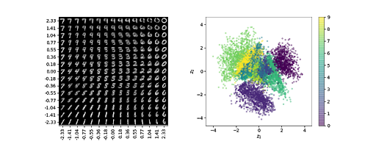
Variational Autoencoders

Slide 2
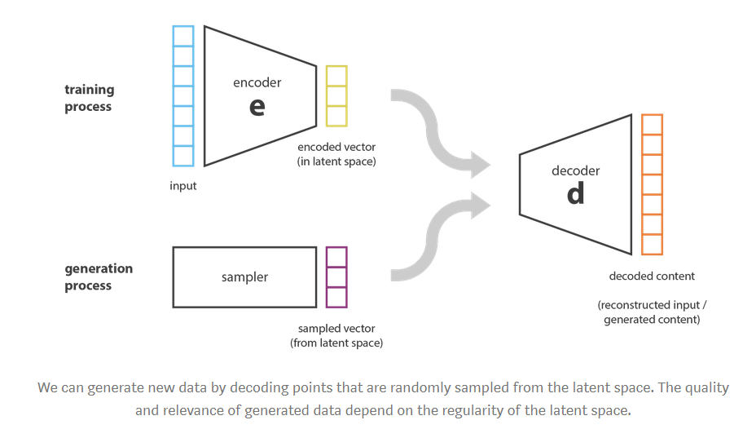
Limitations of autoencoders for content generation
If the latent space is regular enough (well “organized” by the encoder during the training process), we could take a point randomly from the latent space and decode it to get a new content
The decoder would then act like the generator of a Generative Adversarial Network.

Slide 3
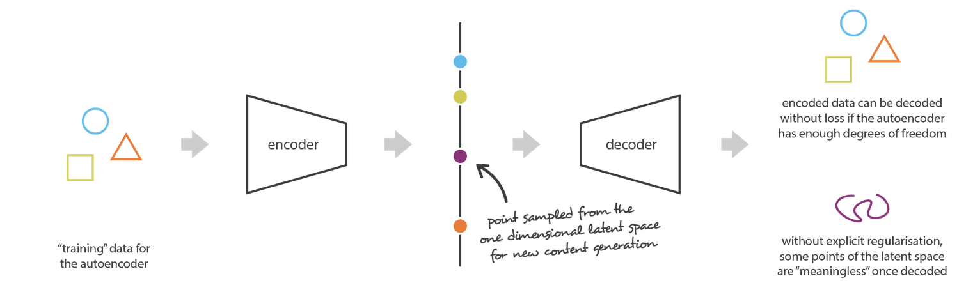
Limitations of autoencoders for content generation
Nothing in the task the autoencoder is trained for enforce to get such organization the autoencoder is only trained to encode and decode with as few loss as possible, no matter how the latent space is organized.

Slide 4
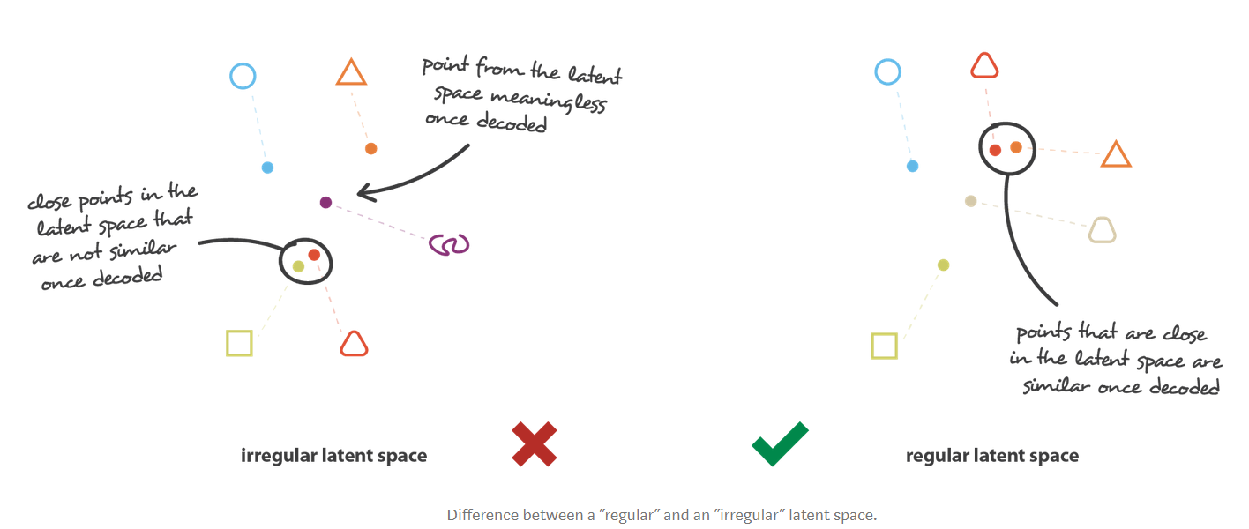
Limitations of autoencoders for content generation

Slide 5
Variational autoencoders
Can be defined as being an autoencoder whose training is regularized to avoid overfitting and ensure that the latent space has good properties that enable generative process.
In order to introduce some regularization of the latent space, we proceed to a slight modification of the encoding-decoding process: instead of encoding an input as a single point, we encode it as a distribution over the latent space

Slide 6
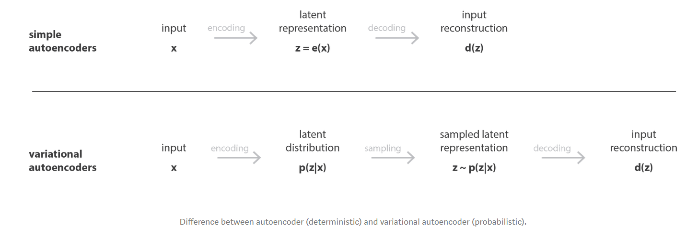
VAE Training

Slide 7
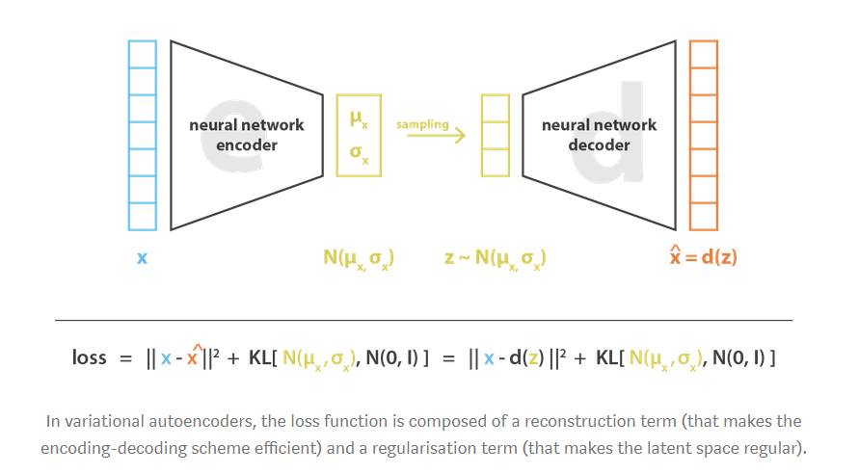
VAE Loss
The loss function that is minimized during the training is composed of 2 parts :
A “reconstruction” term that tends to make the encoding-decoding scheme as reliable as possible (as in a regular autoencoder)
A “regularization” term that tends to regularize the organization of the latent space by making the distributions returned by the encoder as close the a standard normal distribution
KL : Kulback-Leibler Divergence

Slide 8
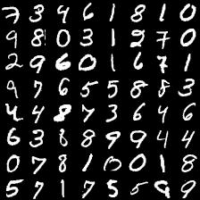
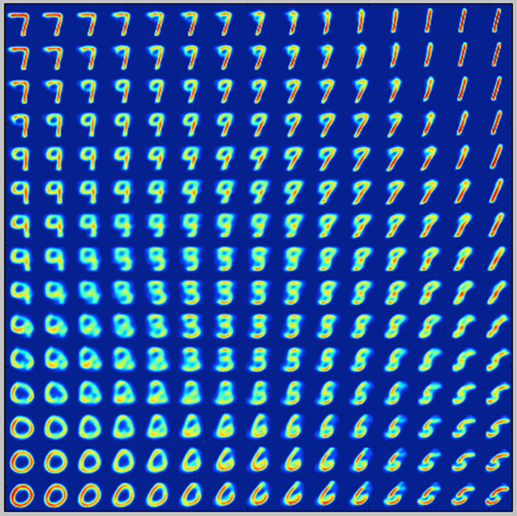
Example : MNIST handwritten digit dataset
Content
Generation
MNIST Dataset

Slide 9
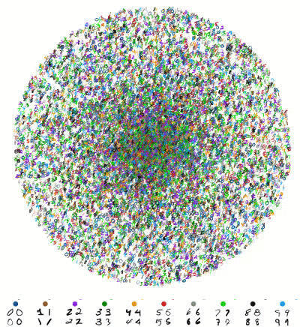
QUESTIONS ?

